Slide 1


Embedded Systems Workshop
Session
7

Slide 2



Hello!
Instructor:
Fatma Ahmed & Loay Ahmed
Cairo University, EECE Department.

Slide 3


connection Linkedin
Fatma Ahmed
Loay Ahmed

Slide 4


Content
Timer Modes
Prescalers
Input Capture

Slide 5

Timer Modes

Slide 6

What are Timers in ATmega32?
we often need the microcontroller to measure time, generate delays, create PWM signals, or count external events. Instead of wasting CPU time using software delays, we use hardware timers, which run independently in the background.
ATmega32 has hardware timers/countersThey are driven by: ​
Internal clock (system clock / prescaler) .​
Or an external signal (for counting).​

Slide 7
Timers are widely used in
Delays
PWM (motor control, LED dimming)
Frequency measurement
Event counting
ATmega32 Timers are :
Timer0 → 8-bit
Timer1 → 16-bit
Timer2 → 8-bit
we will focus on the modes, not the specific timer

Slide 8
Timer Modes
In ATmega32, timers mainly work in three common modes.
1. Normal Mode
Idea:
Timer counts upwards from 0
When it reaches the maximum value, it overflows and starts again from 0

Slide 9
Details :
8-bit timer → overflows at 255 .
16-bit timer → overflows at 65535 .
Overflow sets a flag → can trigger an interrupt .
Use cases :
Simple time delays
Time measurement
Periodic tasks

Slide 10
2. CTC Mode
Idea:
Timer counts from 0 up to a value you choose .
When it reaches the compare value → it resets to 0 automatically advantages.
You control exact timing .
No need to wait for full overflow .
Key register:
OCRx (Output Compare Register)

Slide 11
Use cases :
Accurate delays
Periodic interrupts
Signal generation
In CTC mode, the timer resets when it reaches a predefined value instead of overflowing.
3. Fast PWM Mode
Important concept:
Duty cycle → controlled by OCRx
Frequency → controlled by timer resolution + prescaler

Slide 12
Why PWM matters :
Motor speed control .
LED brightness control .
Power contro.
So in summary, timers in ATmega32 allow us tohandle time-based operations efficiently usingdifferent modes like Normal, CTC, and Fast PWM,each suited for specific applications.

Slide 13
Prescalers

Slide 14
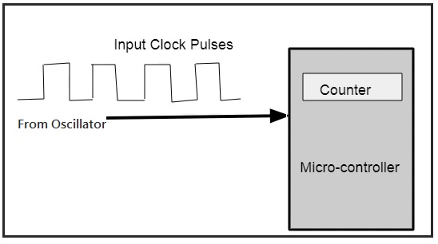

Slide 15

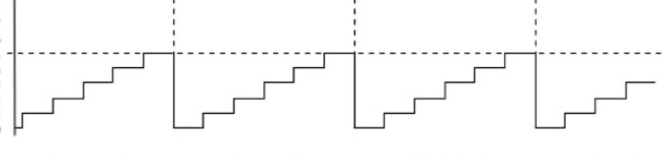


0 0 0 0 0 0 0 0
1 1 1 1 1 1 1 1

Slide 16
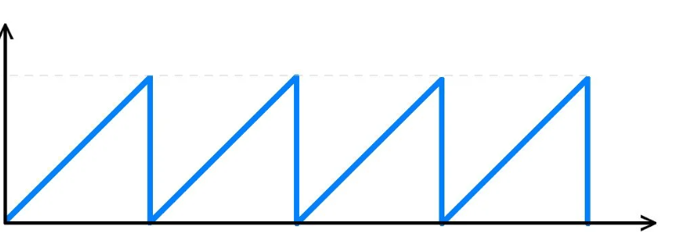
N
T
T(total)=T(Clock) x N
T(Clock)=1/F(Clock)

Slide 17
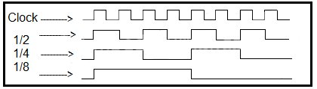

Slide 18
Why Do We Need a Prescaler?
Microcontrollers run at very high clock frequencies.
Typical example:
System clock = 1 MHz
Timer = 8-bit → counts from 0 to 255
The timer increments once every clock tick.

Slide 19
What is a Prescaler?
A Prescaler is a clock divider placed before the Timer.
It divides the clock frequency by a fixed number.

Slide 20
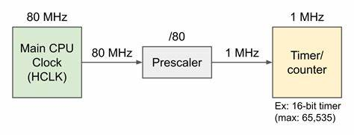
T(clock)=1/F(clock)/pre =pre/F(clock)

Slide 21
What do we need to setup Timer + Prescaler?
Select Timer(Timer0 → 8-bit)
Know System Clock (microcontroller 16 MHz)
Decide Desired Delay

Slide 22
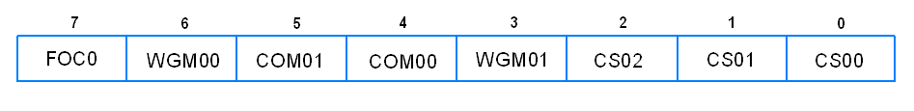
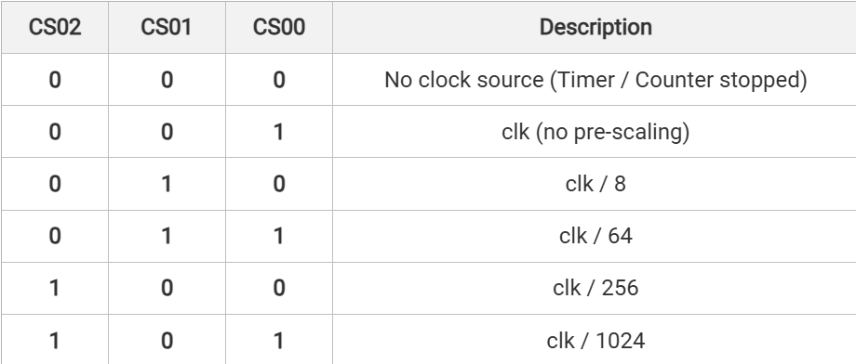
Prescaler

Slide 23
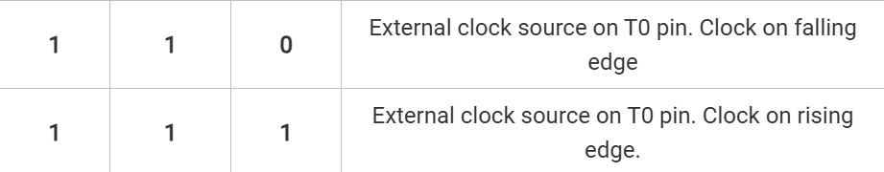
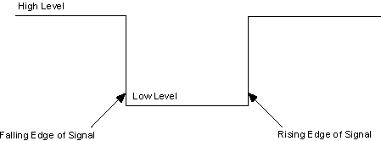

Slide 24
Input Capture

Slide 25
What is Input Capture?
Input Capture is a timer feature that allows the microcontroller to capture the exact timer value when an external event occurs
(like a rising or falling edge on a pin).

Slide 26
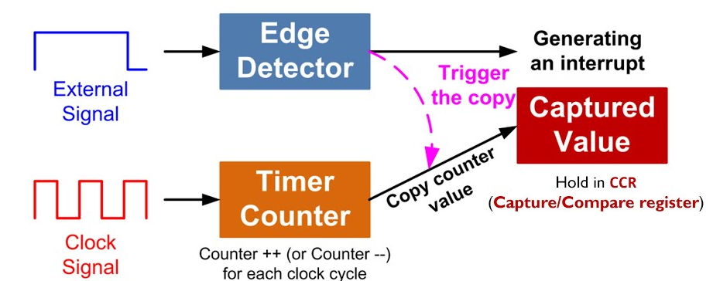

Slide 27
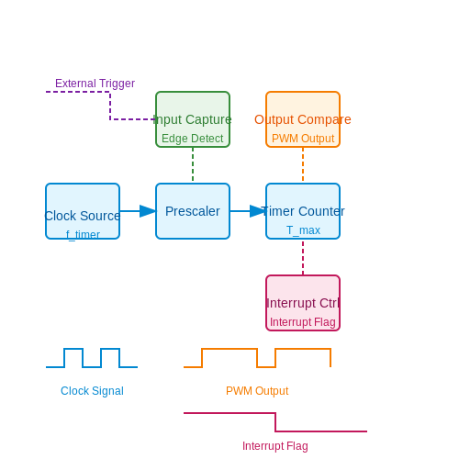

Slide 28
Input Capture Pin:
The Input Capture Pin is a special pin connected directly to a timer inside the microcontroller.
The timer value is automatically copied into a register called Input Capture Register (ICR)

Slide 29
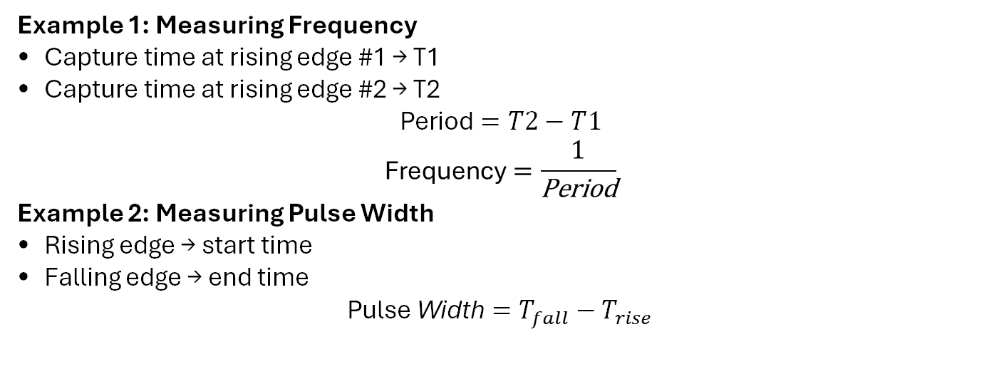
What Do We Use Input Capture For?
Example 1: Measuring Frequency
Capture time at rising edge #1 → T1
Capture time at rising edge #2 → T2
$$\text{Period}=T2−T1$$
$$\text{Frequency}=\frac{1}{\text{Period}}$$
Example 2: Measuring Pulse Width
Rising edge → start time
Falling edge → end time
$$\text{Pulse} \text{Width}=T_{fall}−T_{rise}$$

Slide 30
Session Task​
Write Embedded C code using ATmega16/32 µC to control led using Timer0. Requirements: • Configure the µC clock with internal 1Mhz Clock. • The led is connected to pin 0 in PORTC. • Connect the Led using Positive Logic configuration. • Configure the timer clock to F_CPU/1024. • Toggle the led every half second. • Use the Timer0 Normal Mode with Polling technique.

Slide 31
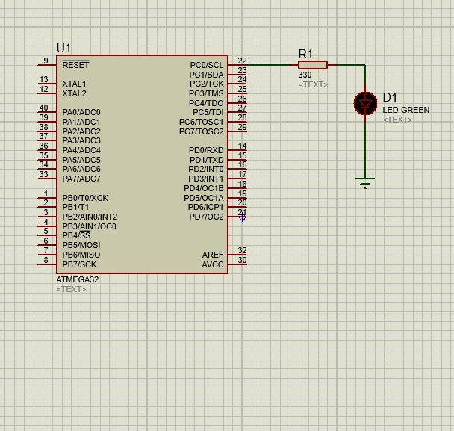

Slide 32
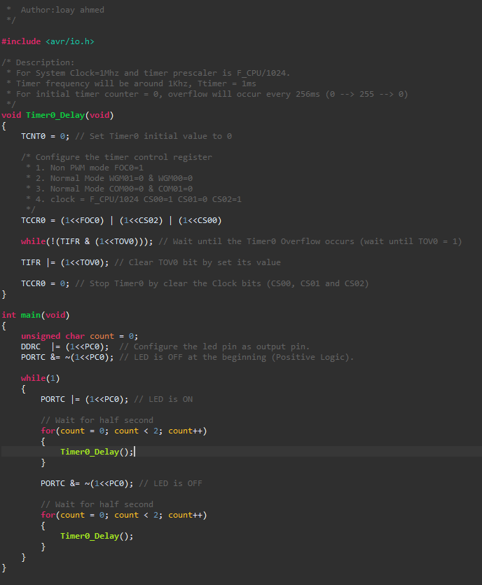

Slide 33
Session Task
Two LEDs:
1. One blinks fast
2. One blinks slow

Slide 34
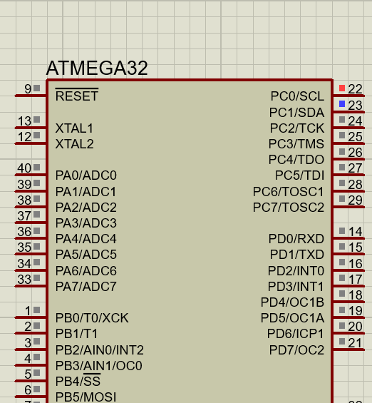
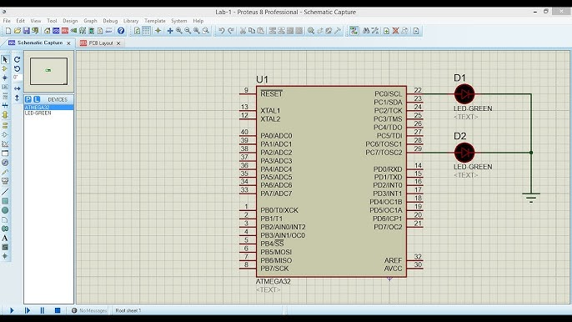

Slide 35
#define F_CPU 8000000UL
#include <avr/io.h>
#include <avr/interrupt.h>
volatile uint16_t fast_count = 0;
volatile uint16_t slow_count = 0;
ISR(TIMER0_OVF_vect){
fast_count++;
slow_count++;
if (fast_count >= 30){
PORTC ^= (1 << PC0); fast_count = 0;
}
if (slow_count >= 60) {
PORTC ^= (1 << PC7);
slow_count = 0;
}
}

Slide 36
int main(void) {
DDRC |= (1 << PC0) | (1 << PC7);
TCCR0 = (1 << CS02) | (1 << CS00);
TIMSK |= (1 << TOIE0);
sei(); while (1) {
} }

Slide 37
HOME Task​
Modify traffic project • replace delays with hardware timers

Slide 38
Thank You!
Any questions?

